Slide 1
Data Compression

Slide 2
COMPRESSION PRINCIPLES
It is desirable to compress digital audio, image, and video so that their bit rates or storage requirements become manageable.
We achieve data compression by exploiting two major factors:
redundancy existing in digital audio, image, and video data
the properties of human perception.

Slide 3
Data Redundancy
digital audio is a series sample values.
An image is a rectangular array of sample values (pixel values)
video is a sequence of images played out at a certain rate.
Redundancy refers to “storing extra information to represent a quantity of information”
Removal of redundancy does not change the meaning of the data.

Slide 4
Redundancy in Digital Audio
In most cases, adjacent audio samples are similar.
The next sample value can be predicted to some extent based on the current sample value.
Compression techniques that use this feature are called predictive coding.
During a normal conversation, we talk for only a very small percentage of time. Between talking spurts, there is silence. Samples corresponding to this silence can be removed without affecting the meaning of the speech.
Compression techniques that use this feature are called silence removal.

Slide 5
Redundancy in Digital Images
In a digital image, neighboring samples on a scanning line are normally similar.
Neighboring samples on adjacent lines are also similar. These similarities are called spatial redundancy.
Spatial redundancies can be removed using predictive coding techniques and other techniques (such as transform coding).

Slide 6
Redundancy in Digital Video
Digital video is a sequence of images, thus it also has spatial redundancies.
Neighboring images in a video sequence are normally similar.
This similarity is called temporal redundancy and can be removed by applying predictive coding between images.

Slide 7
Human Perception Properties
This means that the compressed version does not need to represent the original information samples exactly.
This is in contrast to the conventional alphanumeric data where any data loss or error is normally not allowed, especially for computer programs.
The above feature indicates that human perception is generally not sensitive to small

Slide 8
Classifications of Compression Techniques
can be classified in many ways according to different criteria.
classify them based on the results of the compression techniques.
Two classifications we will consider are whether the original data can be reconstructed exactly after using a compression technique, and whether the output of a compression system is of constant bit rate.

Slide 9
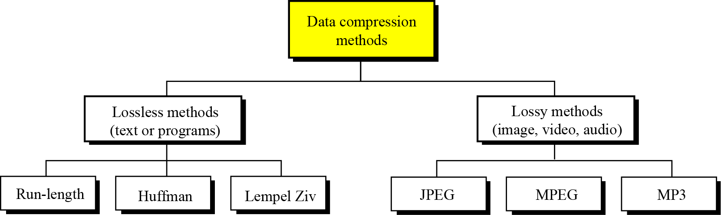
Data Compression Techniques/methods can be divided into two broad categories: lossless and lossy methods.

Slide 10
LOSSLESS COMPRESSION
The integrity of the data is preserved.
The original data and the data after compression and decompression are exactly the same because, in these methods, the compression and decompression algorithms are exact inverses of each other: no part of the data is lost in the process.
Redundant data is removed in compression and added during decompression.
This methods are normally used when we cannot afford to lose any data.

Slide 11
Run-length encoding
The simplest method of compression.
The general idea behind this method is to replace consecutive repeating occurrences of a symbol by one occurrence of the symbol followed by the number of occurrences.

Slide 12
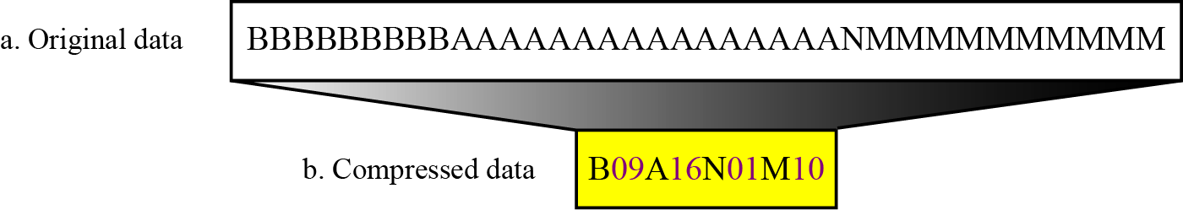
Run-length encoding example

Slide 13
Huffman coding
Assigns shorter codes to symbols that occur more frequently.
For example, we have a text file that uses only five characters (A, B, C, D, E).
Before we can assign bit patterns to each character, we assign each character a weight based on its frequency of use. In this example, assume that the frequency of the characters is as shown in Table 15.1.

Slide 14
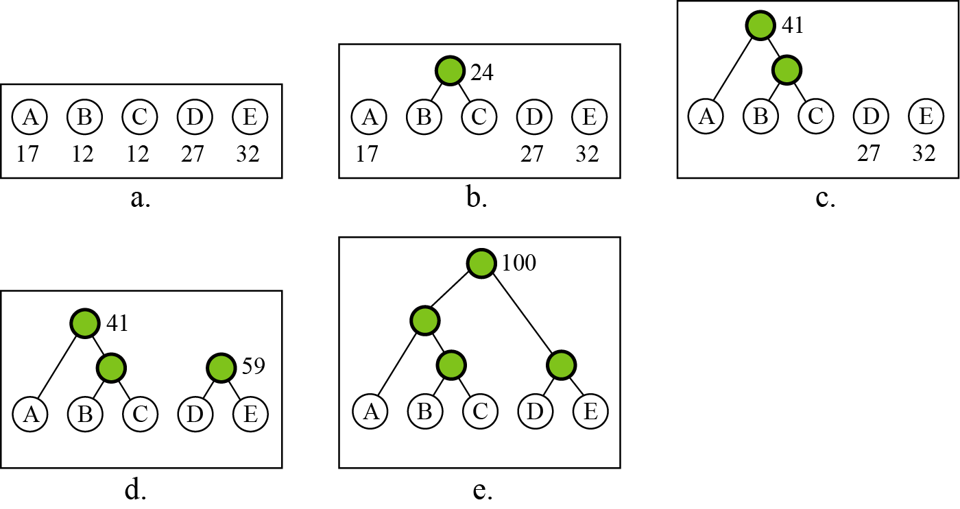
Figure 15.4 Huffman coding

Slide 15
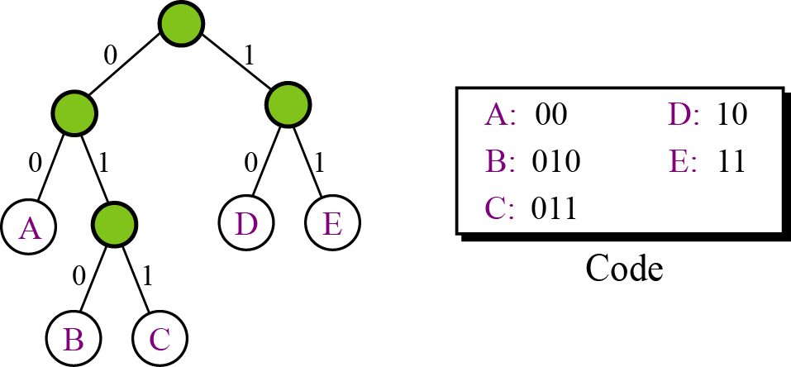
A character’s code is found by starting at the root and following the branches that lead to that character. The code itself is the bit value of each branch on the path, taken in sequence.
Figure 15.5 Final tree and code

Slide 16
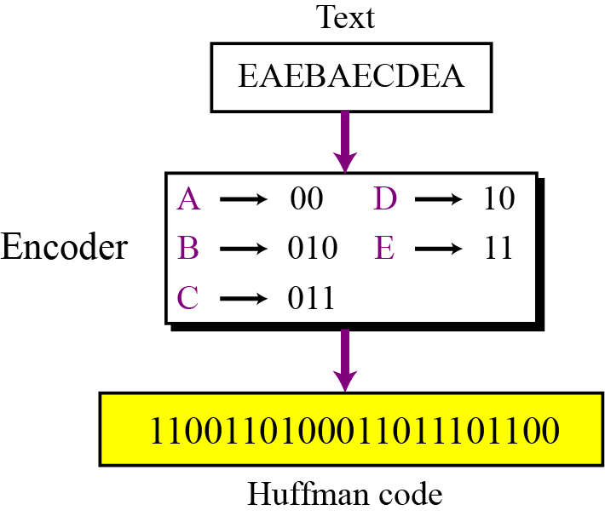
Encoding
Let us see how to encode text using the code for our five characters. Figure 15.6 shows the original and the encoded text.
Figure 15.6 Huffman encoding

Slide 17
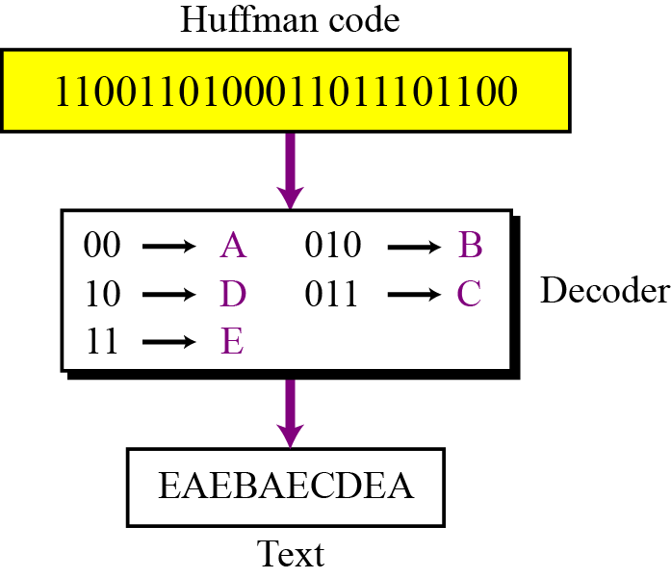
Decoding
The recipient has a very easy job in decoding the data it receives. Figure 15.7 shows how decoding takes place.
Figure 15.7 Huffman decoding

Slide 18
Advantages of Huffman Encoding:
This encoding scheme results in saving lot of storage space, since the binary codes generated are variable in length
It generates shorter binary codes for encoding symbols/characters that appear more frequently in the input string.
Disadvantages of Huffman Encoding
a lower compression ratio compared to lossy encoding techniques.
Huffman encoding are considerably slower than others.

Slide 19
Lempel Ziv encoding
called dictionary-based encoding.
LZW compression works by reading a sequence of symbols, grouping the symbols into strings, and converting the strings into codes.
Because the codes take up less space than the strings they replace, we get compression

Slide 20
Compression
There are two concurrent events:
Building an indexed dictionary
Compressing a string of symbols.
The algorithm extracts the smallest substring that cannot be found in the dictionary from the remaining uncompressed string.
It then stores a copy of this substring in the dictionary as a new entry and assigns it an index value.
Compression occurs when the substring, except for the last character, is replaced with the index found in the dictionary.
The process then inserts the index and the last character of the substring into the compressed string.

Slide 21
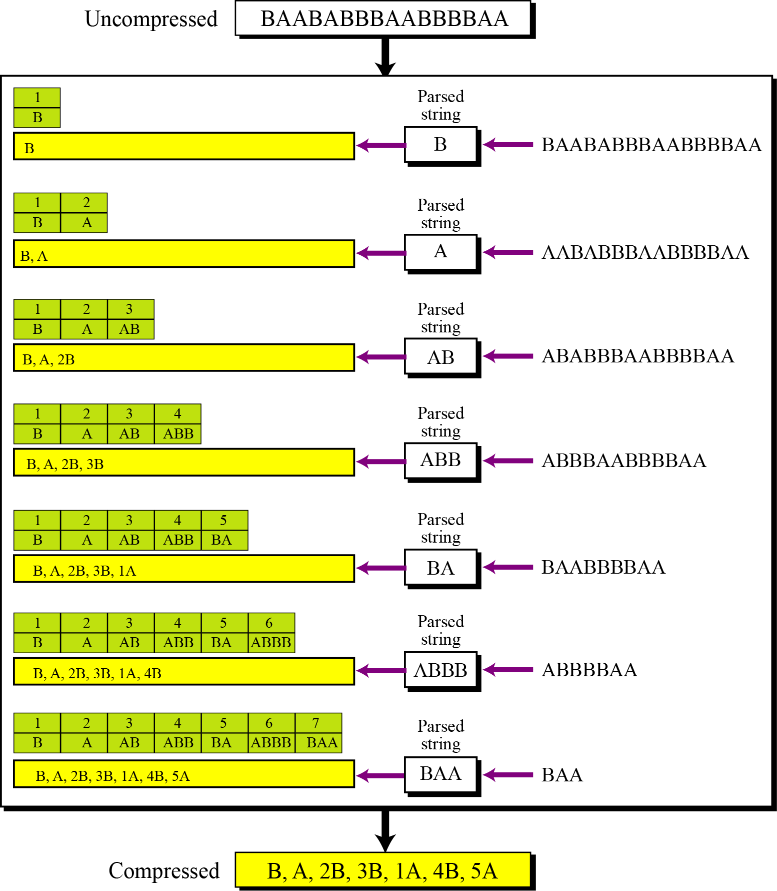
Figure 15.8 An example of Lempel Ziv encoding

Slide 22
Decompression
Decompression is the inverse of the compression process.
The process extracts the substrings from the compressed string and tries to replace the indexes with the corresponding
entry in the dictionary, which is empty at first and built up gradually.
The idea is that when an index is received, there is already an entry in the dictionary corresponding to that index.

Slide 23
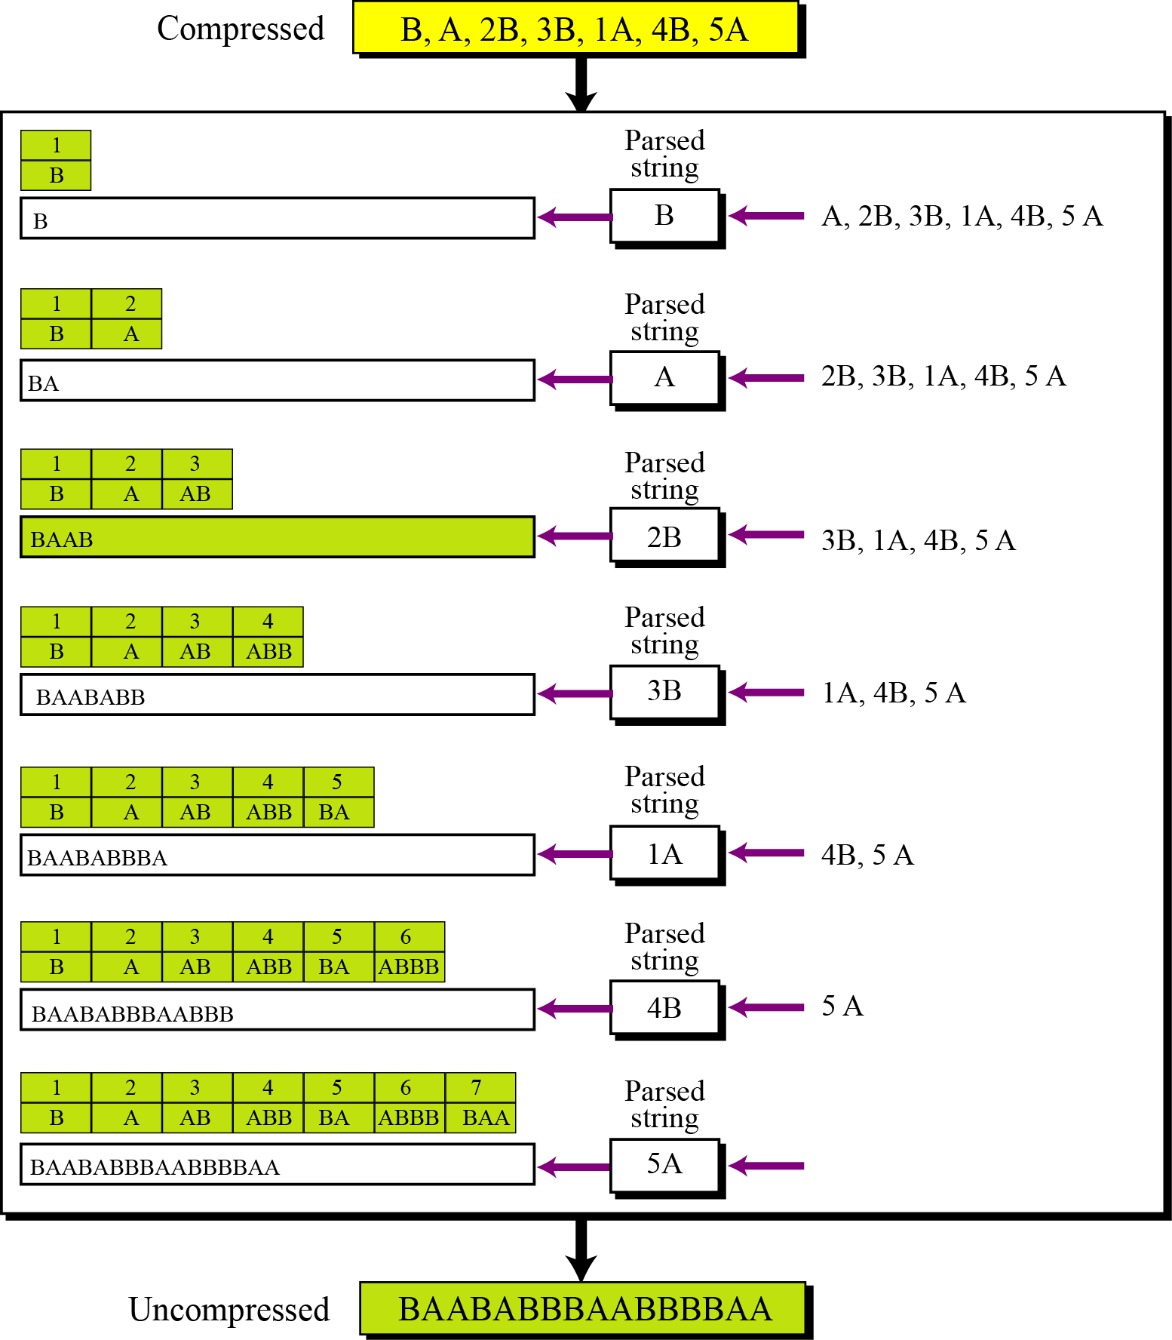
Figure 15.9 An example of Lempel Ziv decoding

Slide 24
LOSSY COMPRESSION METHODS
Our eyes and ears cannot distinguish subtle changes.
In such cases, we can use a lossy data compression method.
These methods are cheaper
they take less time and space when it comes to sending millions of bits per second for images and video.
Several methods have been developed using lossy compression techniques.
JPEG (Joint Photographic Experts Group) encoding is used to
compress pictures and graphics.
MPEG (Moving Picture Experts Group) encoding is used to
compress video,
MP3 (MPEG audio layer 3) for audio compression.

Slide 25
Image compression – JPEG encoding
an image can be represented by a two-dimensional array (table) of picture elements (pixels).
A grayscale picture of 307,200 pixels is represented by 2,457,600 bits, and
a color picture is represented by 7,372,800 bits.

Slide 26
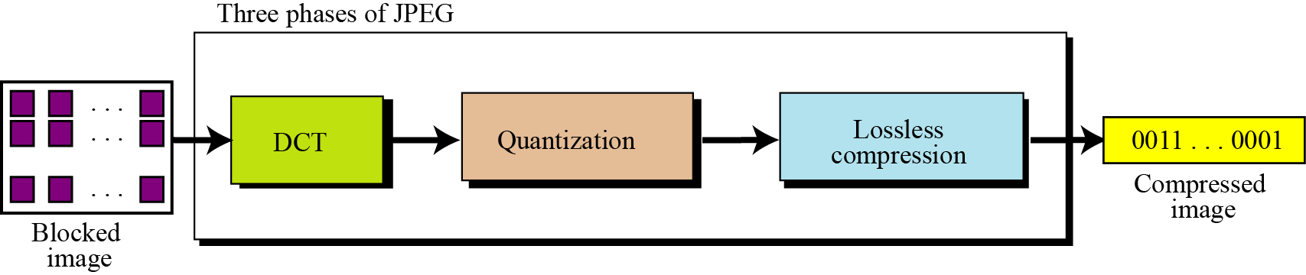
JPEG converts the picture into a set of vectors which creates redundancy.​
The redundancies can then be removed using one of the lossless compression methods we studied previously.
Figure 15.11 The JPEG compression process

Slide 27
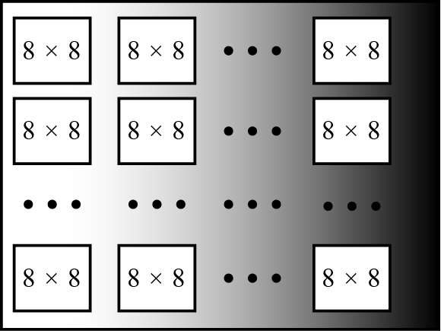
In JPEG, ​ a grayscale picture is divided into blocks with a block size of 8 × 8 pixels, to reduce the number of calculations.​ the number of mathematical operations of each image is the square of the number of units.
JPEG grayscale example, 640 × 480 pixels

Slide 28
Discrete cosine transform (DCT)
Each block of 64 pixels is transformed by a discrete cosine transform (DCT).​
The transformation changes the 64 values so that the relative relationships between pixels are kept but the redundancies are revealed.

Slide 29
The transform coding process using DCT.
We apply a two-dimensional DCT on an image block of 8-by-8 elements.
For forward transform, from definition [6] we have
C = BAB^{T}
where :
C is a transformed coefficient matrix of 8-by-8 elements.
B the DCT transform matrix whose entries are defined
below.
A an image data matrix of 8-by-8 elements to be coded.
B^{T} denotes the transpose of B.

Slide 30
For inverse DCT (IDCT), we have
A = B^{T} CB

Slide 31
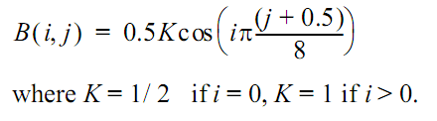
For two-dimensional DCT with block size of 8-by-8, we denote the entries of B by B(i, j), where i is the row index from 0 to 7 and j the column index from 0 to 7.
According to the definition, we have

Slide 32
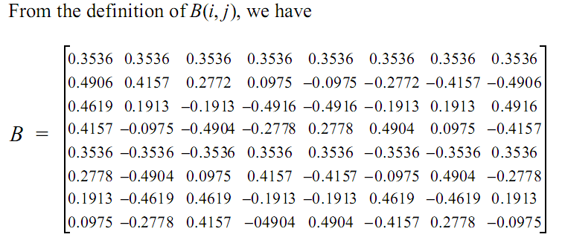

Slide 33
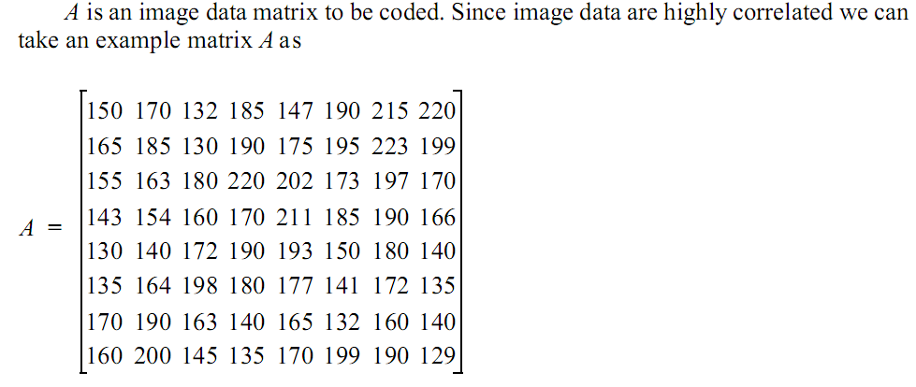

Slide 34
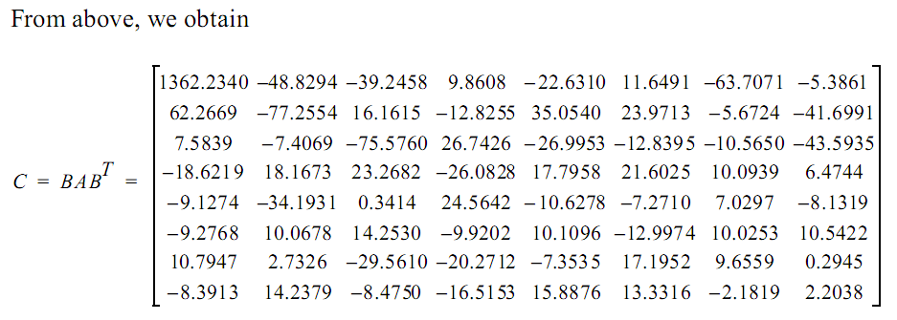
Notice that after the transformation, most energy is packed at the top left corner of C. This means that image data are decorrelated after the transform.

Slide 35
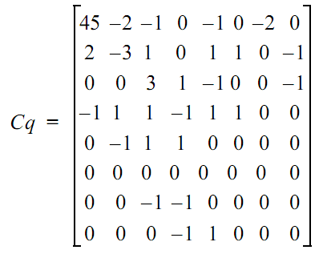
After quantization of the coefficients (here each entry is divided by 30 and results are rounded off to the nearest integer), we obtain

Slide 36
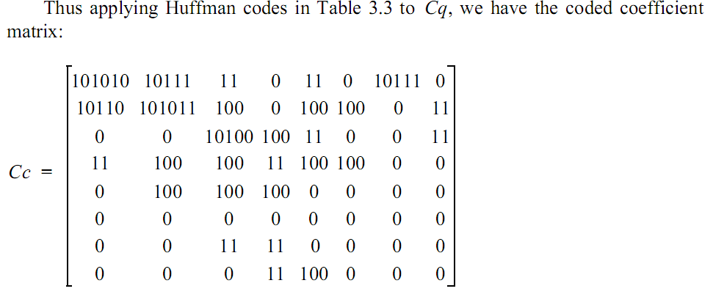

Slide 37
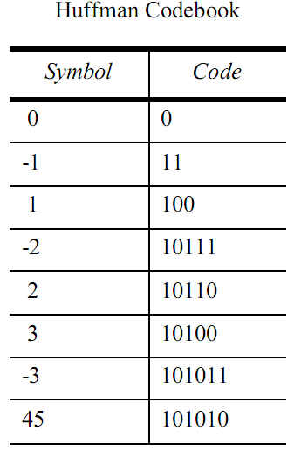

Slide 38
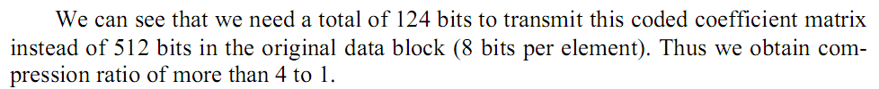

Slide 39
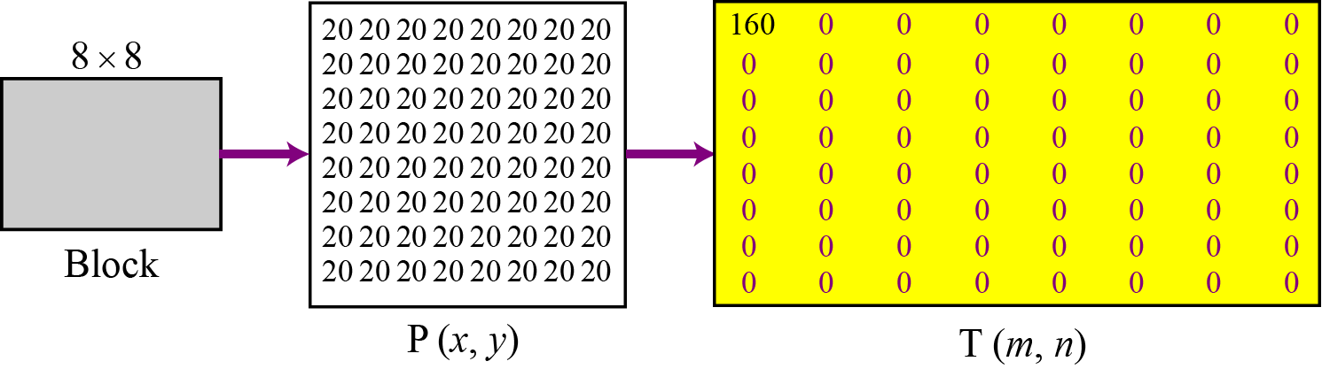
To understand the nature of this transformation, let us show the result of the transformations for three cases.
Figure 15.12 Case 1: uniform grayscale

Slide 40
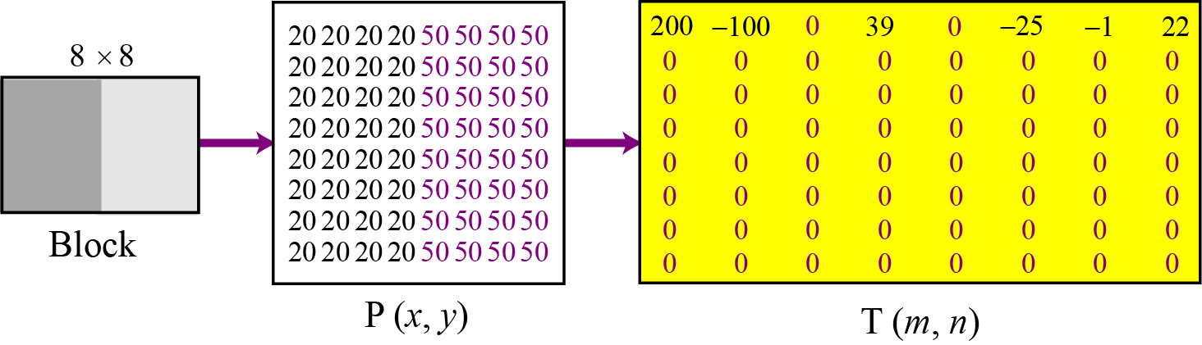
Figure 15.13 Case 2: two sections

Slide 41
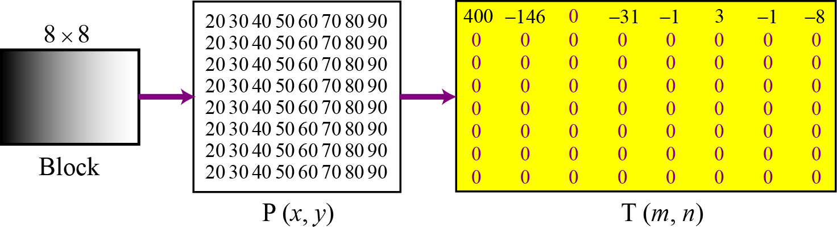
Figure 15.14 Case 3: gradient grayscale

Slide 42
Video compression – MPEG encoding
. The Moving Picture Experts Group (MPEG) method is used to compress video.
. In principle, a motion picture is a rapid sequence of a set of frames in which each frame is a picture.
. In other words, a frame is a spatial combination of pixels, and a video is a temporal combination of frames that are sent one after another.
. Compressing video, then, means spatially compressing each frame and temporally compressing a set of frames.

Slide 43
Spatial compression
The spatial compression of each frame is done with JPEG, or a modification of it. Each frame is a picture that can be independently compressed.
Temporal compression
In temporal compression, redundant frames are removed. When we watch television, for example, we receive 30 frames per second. However, most of the consecutive frames are almost the same. For example, in a static scene in which someone is talking, most frames are the same except for the segment around the speaker’s lips, which changes from one frame to the next.

Slide 44
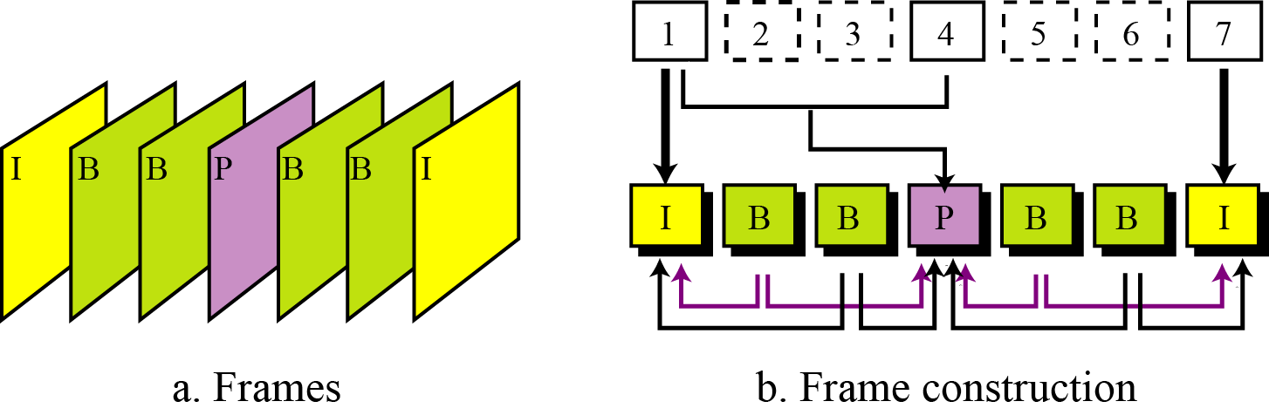
Figure 15.16 MPEG frames

Slide 45
Audio compression
Audio compression can be used for speech or music. For speech we need to compress a 64 kHz digitized signal, while for music we need to compress a 1.411 MHz signal. Two categories of techniques are used for audio compression: predictive encoding and perceptual encoding.

Slide 46
Predictive encoding
In predictive encoding, the differences between samples are encoded instead of encoding all the sampled values. This type of compression is normally used for speech. Several standards have been defined such as GSM (13 kbps), G.729 (8 kbps), and G.723.3 (6.4 or 5.3 kbps). Detailed discussions of these techniques are beyond the scope of this book.
Perceptual encoding: MP3
The most common compression technique used to create CD-quality audio is based on the perceptual encoding technique. This type of audio needs at least 1.411 Mbps, which cannot be sent over the Internet without compression. MP3 (MPEG audio layer 3) uses this technique.

Slide 47
Relations for relationship sets
For each relationship set in the E-R diagram, we create a relation (table). This relation has one column for the key of each entity set involved in this relationship and also one column for each attribute of the relationship itself if the relationship has attributes (not in our case).

Slide 48
TUGAS
Jelaskan perbedaan antara kompresi lossless dan kompresi lossy.
Jelaskan teknik koding berikut dan bagaimana kompresi dapat dicapai pada teknik berikut:
teknik run-length encoding
Huffman coding .
Lempel Ziv encoding
Jelaskan idea yang mendasari :
standar JPEG untuk kompresi still images.
Standar MPEG untuk kompresi video.
Standar MP3 untuk kompresi audio.

